Slide 1
Graphical Interfaces for PowerShell
Options and techniques for a GUI-er life
Notes:
Hi guys, thanks for coming.
This is it, the big one. Where we make GUI interfaces using visual basic.
You know Csi. Anybody? Tough crowd.

Slide 2
What are we going to talk about?
The ‘what’s point of this talk’ slide
Techniques to easily add some GUI goodness to our pre-existing PowerShell tools
Notes:
This is ‘Point of this talk’ slide, make sure you’re in the right room
If this sounds good, you’re in the right place. Now a days if about me

Slide 3





Stephen Owen
About me
Senior Consultant, Infrastructure team
Winner 2014 Winter Scripting Games
Microsoft MVP, PowerShell
Admin at PowerShell.org
Blogger at FoxDeploy.com
@FoxDeploy
Stephen@FoxDeploy.com
Notes:
Who Am I ? My Name is Stephen Owen, I work for iVision in the Infrastructure team, dealing mostly in client management tools like Configuration Manager, MDT, Active Directory. But my
Favorite type of work is coming in to address pain points, create tools and automate workflows. Lots of PowerShell!
I was a part of the winning team for the PowerShell.org 2014 Winter Scripting Games, the Kitten Mittens, which was a great and challenging experience.
I am a MVP of PowerShell, one of 78 in the world :0
You can also find a lot of my code online and will see me on various forums like Reddit, Microsoft, and PowerShell.org
I also blog on the web about PowerShell at foxdeploy.com
You might be asking, wait, GUIs?

Slide 4
Why make GUIs? I thought this was all about scripting
Helping someone through a complex script
For tasks where you don’t want someone on the keyboard
When we’re making tools for our colleagues
To make a complex task sample
Password Resets
Unlock an Account
Provision new users
Notes:
PowerShell is a scripting language, first and foremost. The general idea of scripting is to make code that we can run headless on a schedule to automate the painful parts of administration
But we’ll also use powershell for interactive use, and that’s when the GUI options really shine
Don’t want someone on a keyboard - Complex tasks like moving mailboxes, coordinating system shutdown, etc. Might be routine and steps can be delegated to junior staff, but lots of opportunity for mistakes.

Slide 5
What options do we have?
Some Cmdlets offer GUI-like functionality
.Net Form Scripting
Third-Party Tools
Draw our own with Visual Studio!
PowerShell modules like ShowUI
Notes:
So for the rest of this talk, I’ll cover some examples of how to use each of these techniques

Slide 6
GUI like cmdlets
Easy to instantiate an instance of the System.Shell class, for yes no inputs
You down with OGV?
Out-GridView really shines with PassThru

Slide 7
Drawing forms with .Net
Draw a form, then draw each object
Old school approach, but common in online examples and walkthroughs
Very slow, lots of trial and error
Scripts with this type of GUI will be VERY long
Notes:
In this approach to bolting on some GUI goodness, we use two lines of code to load the Windows assemblies of System.Windows.Forms and Drawing, which are how Windows draws most applications we use on a daily basis.
After we do that, we can then go step by step, drawing a canvas, then make new UI elements like textboxes,
the System.Reflection.Assembly class, to load

Slide 8
Third Party tools can natively do it too
Sapien PowerShell Studio
Makes drawing a GUI very easy
Affordable for licenses
Quick to make a GUI, but code will be long
Notes:
Now, if you’re OK with long scripts, Sapien PowerShell Studio is awesome for making GUIs, automating the process I just showed you.
Very quick to make a gui this way, but code is long

Slide 9
Visual Studio as a Canvas
How this works
Make a GUI in Visual Studio, copy XAML
Load the ‘make a GUI with XAML Snippet’
Drag your code into the top here string
Add code to the ‘Use this section…’ area
Enjoy the GUIness

Slide 10
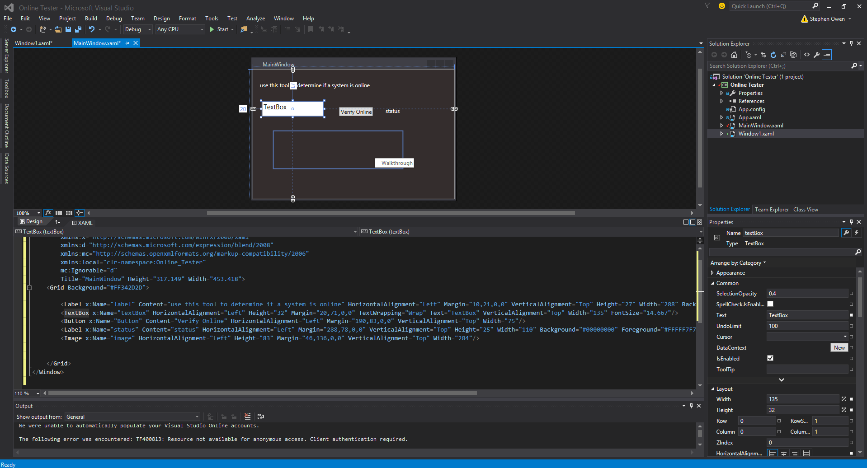
Getting to know Visual Studio
GUI Area
Properties
XAML Area

Slide 11
The GUI PowerShell Module - ShowUI
A bit of a learning curve
Super powerful
Notes:
Put the steps to install ShowUI here
Easier to understand once you try the XAML approach
Consider putting this section at the end

Slide 12
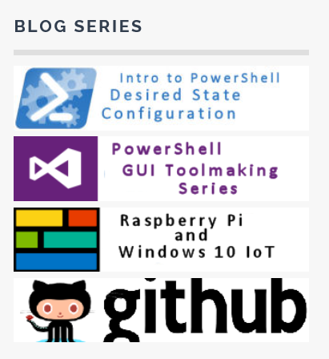
Contact me
Tutorials on working with all sorts of GUI tools on FoxDeploy.com
Click the Purple heading on the right side
Email me Stephen@FoxDeploy.com
Twitter
@FoxDeploy

Slide 13
Question Time!

